Slide 1
CSS
MCNDHS
Ms. Eng

Slide 2
AIM: HOW DO WE CREATE SHADOWS FOR OUR DIV BOXES?
Do now:
No classroom assignment
NOTES and CLASSWORK TODAY
Daily Grade:
On-time/attendance/not leaving the classroom: 25%
Cellphones: 25%
Notes:25%
Classwork/Homework: 25%

Slide 3
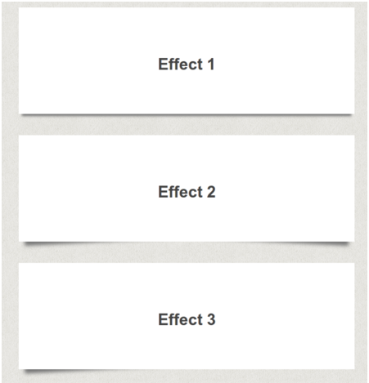
WHAT ARE WE LEARNING TODAY:

Slide 4
BASICS:
CSS:
box-shadow: left/right up/down amountOfShadow spreadofShadow #color;

Slide 5

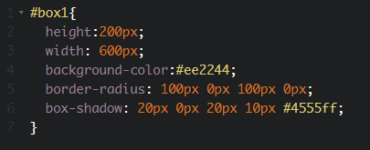

HTML/CSS

Slide 6


ACTIVITY:

